Slide 1
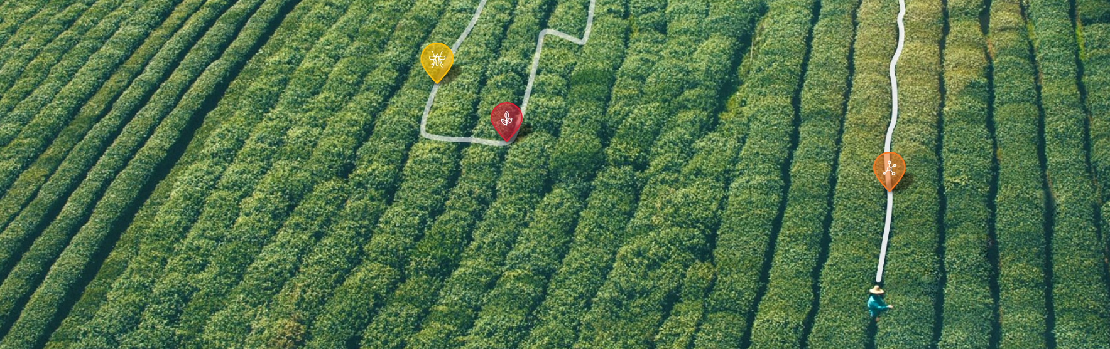
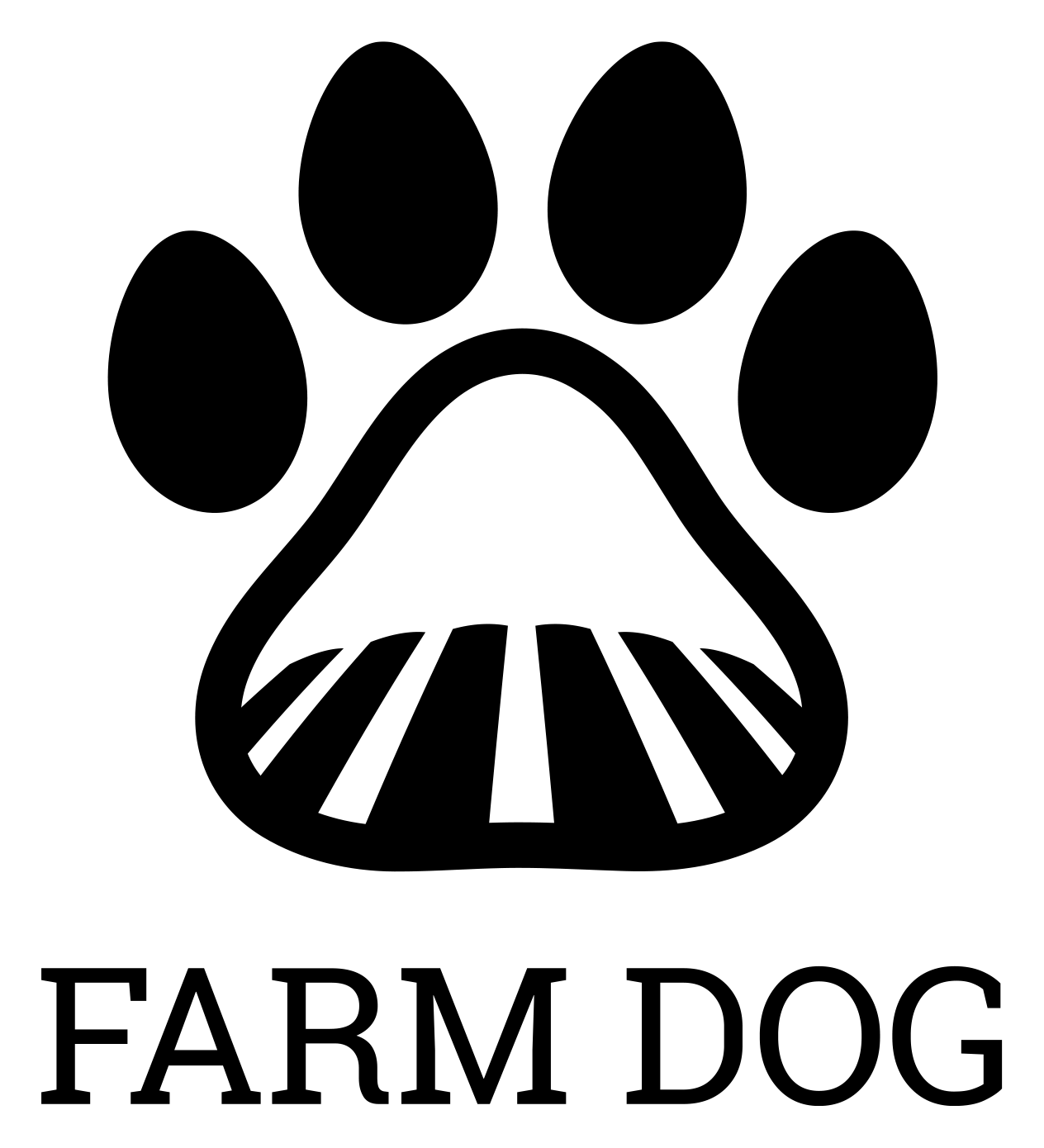
Keeping fields safe from pest and disease
April 3, 2017

Slide 2
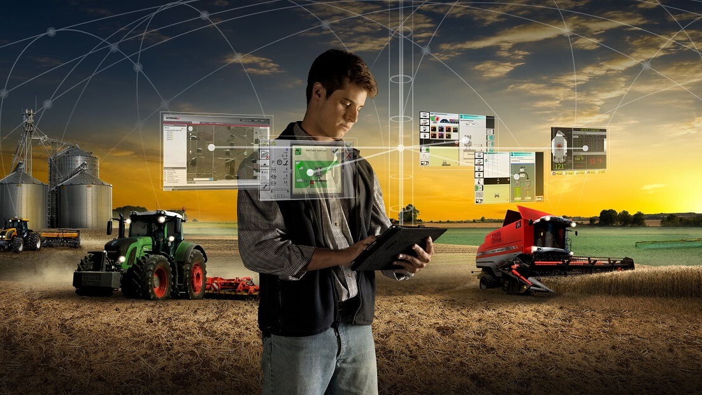
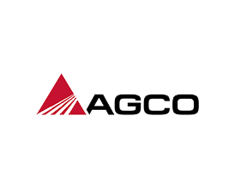
WHAT IS AGRICULTURE TECHNOLOGY?
Photo source:

Slide 3
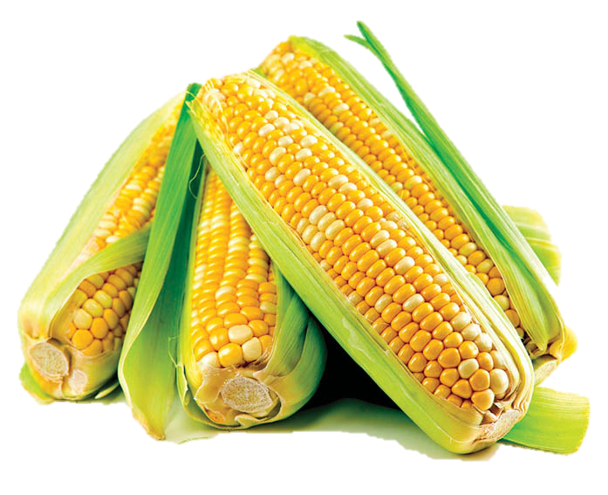
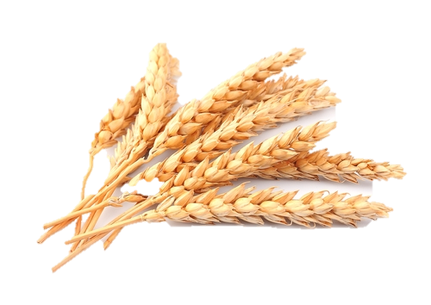
WHY THE EXCITEMENT?
Yield improve-ments
Cost savings
$25/acre savings using yield mapping
(5% of costs)
€10- €25/hectare savings using variable nitrogen application
(10% of costs)
Environ-mental benefits
Sources: USDA Economic Research Service; European Parliament Directorate-General for Internal Policies

Slide 4
YET AGTECH ADOPTION CONSIDERABLY TRAILS THE HYPE
$3B in AgTech investments in 2016
Hype
43% use yield monitor*
14% use VRT pest-icide*
2% use UAVs*
18% use aerial imagery*
Adoption
Sources: AgFunder; Purdue University
*Estimate of acres utilizing the technology based on dealer survey

Slide 5
CULTURAL FACTORS PLAY A KEY ROLE IN SLOWING ADOPTION
High risk – no in-season re-do’s
Each growing season is valuable
few inputs per growing season
brand loyalty in agriculture is strong

Slide 6
THERE ARE NO RE-DO’S
Planting date effects on yield
% of maximum yield
Weeks after optimum planting date

Slide 7
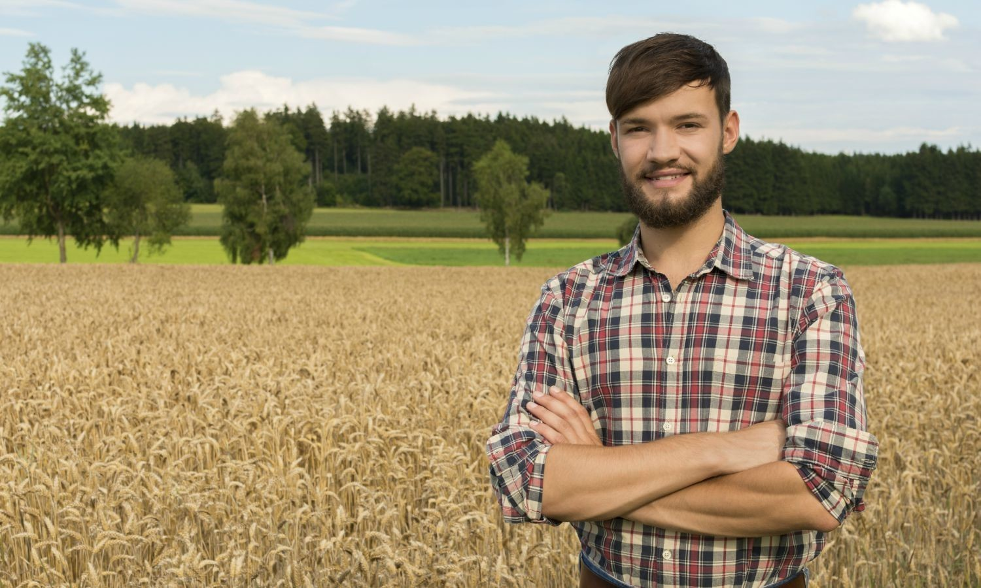
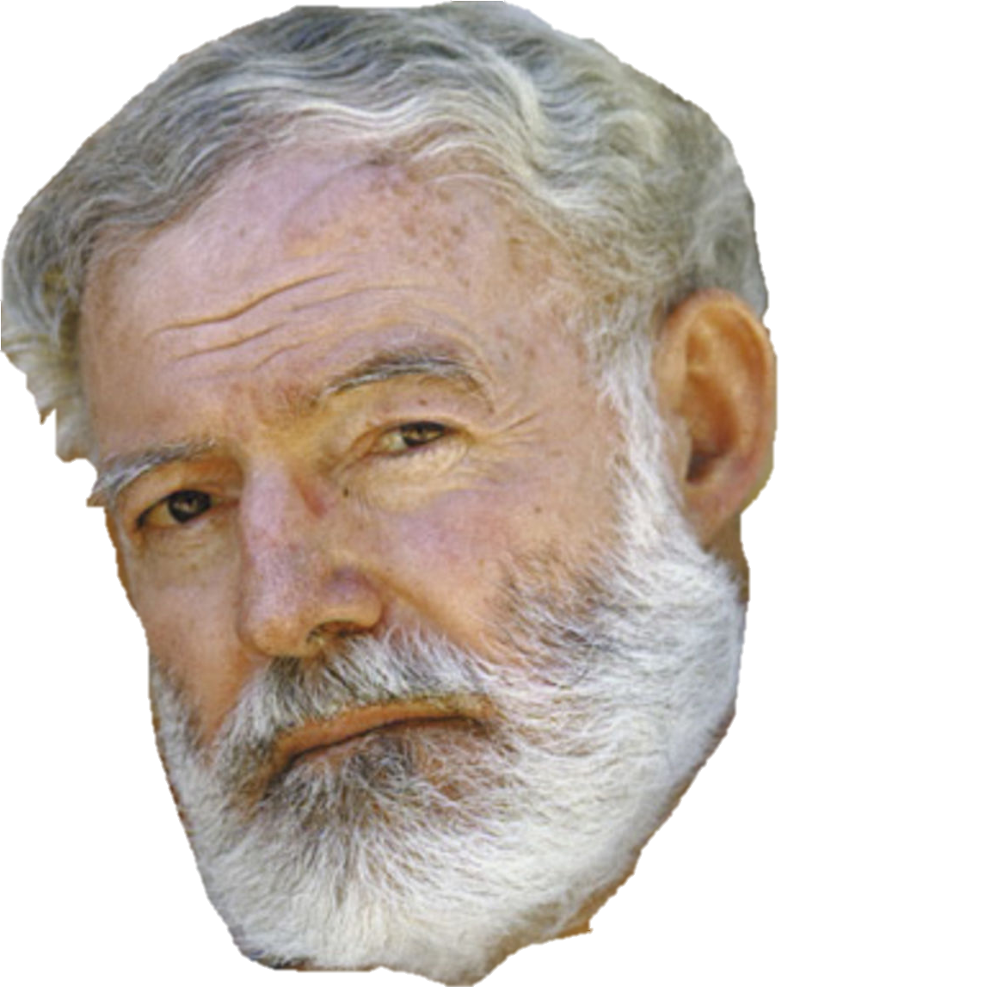
A FARMER has on average 40 growing seasons

Slide 8
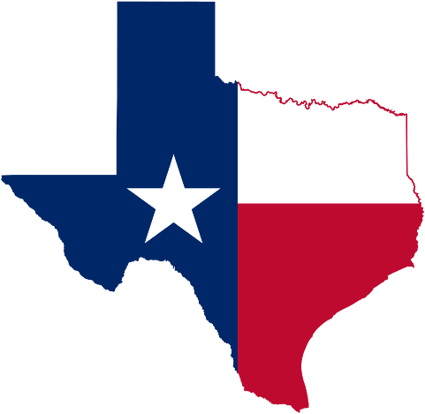
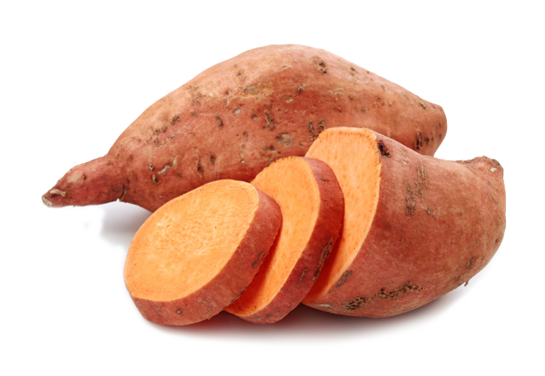
AGRICULTURE = FEWER PRODUCT FEEDBACK LOOPS
~4 months from sowing until harvest, you get to ask once from each user:
What happened to yield?
What happened to crop inputs?
What happened to time spent?
Over 4 months of driving, you get to ask, 400+ times from each user:
Did I get to my destination?
How fast did I get there?
Sources: US Public Interest Research Group; US Department of Transportation; Texas A&M University; USDA

Slide 9
FARMERS ARE BRAND LOYAL
Plan on staying with your current brand?
84%
67%
64%
61%
Sources: RBC Capital Markets (2015); Farm Equipment (2014); Rocket Fuel (2015)

Slide 10
WHAT CAN A STARTUP DO?
Bring value from day 1 – reduce the risk of adoption angst
Specialize – create network effects to avoid growing season limitations
Align with influence leaders – build your own brand loyalty

Slide 11
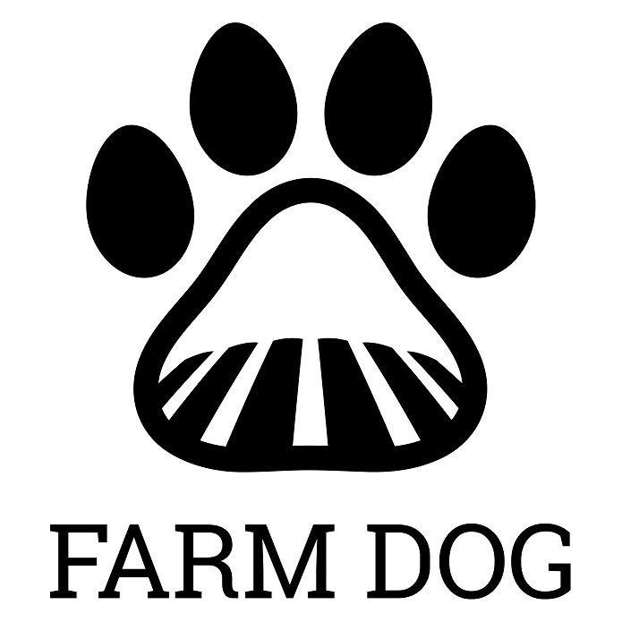
KeepING fields safe from pest and disease

